Slide 1
Datatypes I

Slide 2
Outline
Binary-Decimal Conversion
Arithmetic Operations on Bits
Addition & Subtraction
Trouble In Paradise (Don’t Be Negative...)
Representations & Numbers
A New Hope... (2’s Complement)
Binary-Decimal Conversion (revisited)
Sign Extension and Overflow

Slide 3
Representations
Modern computers effectively store patterns of switches that are set On and Off.
How do we do work with that limitation?
“When I use a word,’ Humpty Dumpty said in rather a scornful tone, ‘it means just what I choose it to mean — neither more nor less.’
’The question is,’ said Alice, ‘whether you can make words mean so many different things.’
’The question is,’ said Humpty Dumpty, ‘which is to be master — that’s all.”
― Lewis Carroll, Through the Looking Glass
In that vein, we choose representations for numbers, letters, and many other things that are “easy” to work with.

Slide 4
Representations & Numbers
What does this mean to you?
5
The number 5?
An Arabic numeral (digit) that represents the number 5?
Could there be other representations?
0101₂, V, •••••

Slide 5
Datatypes
A set of values from which a variable, constant, function, or other expression may take its value. A type is a classification of data that tells the compiler or interpreter how the programmer intends to use it. For example, the process and result of adding two variables differs greatly according to whether they are integers, floating point numbers, or strings.
Patt: "We say a particular representation is a datatype if there are operations in the computer that can operate on information that is encoded in that representation."

Slide 6
Question
What is a bit?

Slide 7
Where do bits come from?
Numeric Bits
Character
Bits
14,000'
Bitaba Tree
Andes Mountains

Slide 8
NOT!

Slide 9
Question
The first computers did decimal arithmetic. Couldn’t we just skip binary?

Slide 10
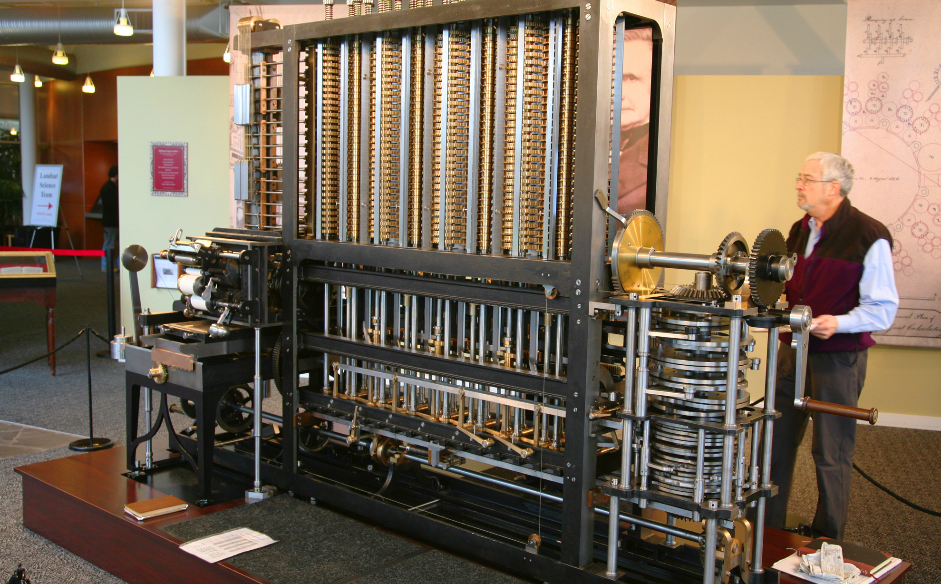
Babbage Difference Engine #2

Slide 11
Difference Engine #2 Video

Slide 12
Decimal or Binary?
History has pretty well determined that binary is the right way to store data and calculate with today’s electronics.
Only computers in the 40s and 50s attempted to store data in decimal.
Up through the 70s, computers binary-coded decimal instructions (store in coded binary, calculate in decimal).
They’re very rare in modern computers.

Slide 13
Question
What is the smallest number of bits we would need to designate 5 different items or states?
How about 16 states?

Slide 14
Quick Review of Base 2 Math
There are only 2 digit values, 0 and 1.
We assign place-values just like base 10, except they are powers of 2
0 1 0 0 0 1 0 0
128 64 32 16 8 4 2 1
0100 0100₂ = 68₁₀
0 0 1 1 1 1 1 1
128 64 32 16 8 4 2 1
0011 1111₂ = 63₁₀

Slide 15
Addition and Subtraction
Work the same way as base 10. Carry if the bit value is > 1; borrow if less than 0.
0000 1111₂ 11 0000₂ +0001 0001₂ - 00 0011₂ ---------------- ------------- 0010 0000₂ 10 1101₂
15+17 = 32 48 – 3 = 45

Slide 16
How Can We Represent Numbers Using Bits?
0 0 1 0 0
1 1 0 0 1
2 1 1 0 0
3 0 0 0 1
4 1 0 1 1
5 0 0 1 1
6 1 1 1 0
7 0 1 0 1
8 0 1 1 0
9 0 0 0 0
10 1 1 0 1
11 0 1 1 1
12 1 0 0 0
13 1 1 1 1
14 1 0 1 0
15 0 0 1 0
Is this a good choice?
How many choices are there?
16! = 20,922,789,888,000
Maybe we can pick a better representation?

Slide 17
Take Advantage of a Pattern?
0 0 0 0 0 0+0+0+0
1 0 0 0 1 0+0+0+1
2 0 0 1 0 0+0+2+0
3 0 0 1 1 0+0+2+1
4 0 1 0 0 0+4+0+0
5 0 1 0 1 0+4+0+1
6 0 1 1 0 0+4+0+1
7 0 1 1 1 0+4+2+1
8 1 0 0 0 8+0+0+0
9 1 0 0 1 8+0+0+1
10 1 0 1 0 8+0+2+0
11 1 0 1 1 8+0+2+1
12 1 1 0 0 8+4+0+0
13 1 1 0 1 8+4+0+1
14 1 1 1 0 8+4+2+0
15 1 1 1 1 8+4+2+1

Slide 18
Hmm. Looks Like Place Value in Base 10.
0 0+0 0 0 0 0 0+0+0+0
1 0+1 0 0 0 1 0+0+0+1
2 0+2 0 0 1 0 0+0+2+0
3 0+3 0 0 1 1 0+0+2+1
4 0+4 0 1 0 0 0+4+0+0
5 0+5 0 1 0 1 0+4+0+1
6 0+6 0 1 1 0 0+4+0+1
7 0+7 0 1 1 1 0+4+2+1
8 0+8 1 0 0 0 8+0+0+0
9 0+9 1 0 0 1 8+0+0+1
10 10+0 1 0 1 0 8+0+2+0
11 10+1 1 0 1 1 8+0+2+1
12 10+2 1 1 0 0 8+4+0+0
13 10+3 1 1 0 1 8+4+0+1
14 10+4 1 1 1 0 8+4+2+0
15 10+5 1 1 1 1 8+4+2+1

Slide 19
Unsigned Integers
How many different numbers can be represented by 4 bits?
How many different numbers can be represented by 7 bits?
How many different numbers can be represented by n bits?

Slide 20
N = 4
Number Represented
Binary
0000
0001
0010
0011
0100
0101
0110
0111
1000
1001
1010
1011
1100
1101
1110
1111
Unsigned
0
1
2
3
4
5
6
7
8
9
10
11
12
13
14
15

Slide 21
Practice Problems
What is 5 + 2 ?
What is 9 + 4 ?
What is 10 – 3 ?
What is 2 – 6 ?

Slide 22
Trouble In Paradise
We are used to dealing with positive and negative integers
What are our options?
One possible approach: reserve one bit to represent the sign of a number

Slide 23
Signed Integers
Signed magnitude
Easy to understand
Fun to be with
Not so good with hardware

Slide 24
N = 4
Number Represented
Binary
0000
0001
0010
0011
0100
0101
0110
0111
1000
1001
1010
1011
1100
1101
1110
1111
Signed
Mag
0
1
2
3
4
5
6
7
-0
-1
-2
-3
-4
-5
-6
-7
Unsigned
0
1
2
3
4
5
6
7
8
9
10
11
12
13
14
15

Slide 25
More Practice Problems
What is 5 + 2 ?
What is 5 – 2 ?
What is 5 + ⁻2 ?
What is 3 + ⁻3 ?

Slide 26
Nagging Concerns...
Why do I have to think about two different operations: addition and subtraction?
How much time will I spend examining the signs and magnitudes of each operand to determine how to find the answer?
And what about plus zero and minus zero representing the same number?
Is there a better way?...

Slide 27
Reality Sets In
Any arbitrary scheme of allowing different bit patterns to represent different numbers could be made to work, but there is an especially clever choice...

Slide 28
A New Hope...
Start with the number line
0

Slide 29
A New Hope...
Let use 4 bits for our representation
This gives us 2⁴ = 16 different values that we can represent
Let’s split them as evenly as possible between positive and negative values
-8
-7
-6
-5
-4
-3
-2
-1
0
1
2
3
4
5
6
7

Slide 30
A New Hope...
Now, start numbering from 0 using our trusty unsigned binary representation
But... what happens when we reach the “end of the line” ? (hint: think odometer)
0000
0001
0010
0011
0100
0101
0110
0111
?
-8
-7
-6
-5
-4
-3
-2
-1
0
1
2
3
4
5
6
7

Slide 31
A New Hope...
Wrap around and keep going!
1000
1001
1010
1011
1100
1101
1110
1111
0000
0001
0010
0011
0100
0101
0110
0111
-8
-7
-6
-5
-4
-3
-2
-1
0
1
2
3
4
5
6
7

Slide 32
...for Signed integers
2's complement
Used in almost all computers manufactured today
Allows for low cost, high performance circuitry to do math operations
Why does it work?

Slide 33
UsefulProperties
There is only one zero
Addition still works as expected from binary arithmetic (if you don’t wrap)
The first bit still indicates the sign (as long as you will tolerate zero being positive)
Finding the complement (additive inverse) of a number is easy
Since finding the complement is easy, there’s no need for subtraction: just complement and add

Slide 34
N = 4
Number Represented
Binary
0000
0001
0010
0011
0100
0101
0110
0111
1000
1001
1010
1011
1100
1101
1110
1111
Unsigned
0
1
2
3
4
5
6
7
8
9
10
11
12
13
14
15
Signed
Mag
0
1
2
3
4
5
6
7
-0
-1
-2
-3
-4
-5
-6
-7
1's
Comp
0
1
2
3
4
5
6
7
-7
-6
-5
-4
-3
-2
-1
-0
2's
Comp
0
1
2
3
4
5
6
7
-8
-7
-6
-5
-4
-3
-2
-1

Slide 35
Two’s-Complement Representation
Note there’s a useful new pattern:
You can find the two’s complement of any number by flipping the bits and adding 1.
And a two’s complement conveniently represents the additive inverse of the originally represented number!

Slide 36
More Practice Problems
What is 5 + 2 ?
What is 5 – 2 ?
What is 5 + ⁻2 ?
What is 3 + ⁻3 ?

Slide 37
Signed integers
1's complement
Used in some early computers
To make a negative just flip all the bits

Slide 38
N = 4
Number Represented
Binary
0000
0001
0010
0011
0100
0101
0110
0111
1000
1001
1010
1011
1100
1101
1110
1111
Unsigned
0
1
2
3
4
5
6
7
8
9
10
11
12
13
14
15
Signed
Mag
0
1
2
3
4
5
6
7
-0
-1
-2
-3
-4
-5
-6
-7
1's
Comp
0
1
2
3
4
5
6
7
-7
-6
-5
-4
-3
-2
-1
-0

Slide 39
Decimal to Binary Conversion
Given a number in decimal how do we convert it to binary two’s complement notation?

Slide 40
Binary to Decimal Conversion
Given a number in two's complement notation how do we convert it to decimal?
Here’s a place to practice!
http://games.penjee.com/binary-numbers-game/

Slide 41
Questions?

Slide 42
Adding Bits
Input A | Input B | Output Sum | Output Carry
0 | 0 | 0 | 0
0 | 1 | 1 | 0
1 | 0 | 1 | 0
1 | 1 | 0 | 1
In other words the output of bit addition is the sum to go in the same bit position and a carry to be added to the next higher bit position.

Slide 43
Overflow
Check carry in and out of the leading digit
Add two numbers; we have problems if
We get a carry into the sign bit but no carry out
We get a carry out of the sign bit but no carry in
If we add a positive and a negative number we won't have a problem
Assume 4 bit numbers (+7 : -8)

Slide 44
Overflow
If we add two positive numbers and we get a carry into the sign bit we have a problem
3 0011 4 0100
3 0011 4 0100
6 0110 8 1000
carry in 0
carry out 0
carry in 1
carry out 0

Slide 45
Overflow
If we add two negative numbers and we don’t get a carries into and out of the sign bit we have a problem
-5 1011 -4 1100
-3 1101 -5 1011
-8 11000 -9 10111
carry in 1
carry out 1
carry in 0
carry out 1

Slide 46
Overflow
If we add a positive and a negative number we won't have a problem
5 0101 -4 1100
-3 1101 5 0101
2 10010 1 10001
carry in 1
carry out 1
carry in 1
carry out 1

Slide 47
Sign Extension
Suppose we have a number which is stored in an four bit register
We wish to add this number to a number stored in a eight bit register
We have a device which will do the addition and it is designed to add two 8 bit numbers
What issues do we need to deal with?

Slide 48
Example
Add 3 and 64 (0011 and 01000000)
Add -3 and 64 (1101 and 01000000)

Slide 49
Sign Extension
To add bits to the left of a two’s complement number (i.e. make the number of bits bigger while representing the same numeric value)…
Fill the new bits on the left with the value of the sign bit!

Slide 50
What happens when we add a number to itself?
00010000
00010000
--------
00100000
00011111
00011111
--------
00111110
00010001
00010001
--------
00100010
00000101
00000101
--------
00001010
01110011
01110011
--------
11100110
01010101
01010101
--------
10101010
00011100
00011100
--------
00111000
00000001
00000001
--------
00000010
A + A is the same as 2 * A is the same as A << 1

Slide 51
Fractional Binary Numbers
What is the place value of the first digit to the right of a decimal point?
10⁻¹
What is the place value of the first bit to the right of a binary point?
2⁻¹
So, what is the decimal value of the following binary number?
1^0 1
= 1.25₁₀
8 4 2 1 ^ .5 .25 .125 .0625
0 1 0 1 1 0 0
1010^1100= 10.75₁₀

Slide 52
Questions

